Slide 1
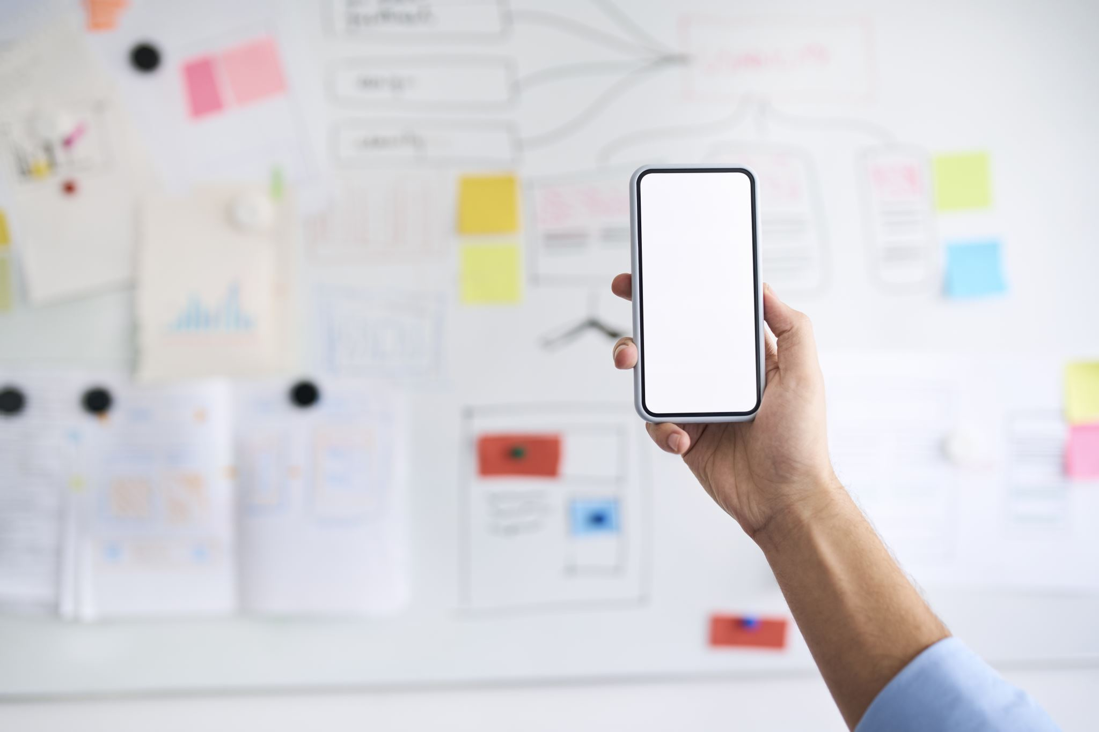
Business Implementation

Slide 2

Overview
During the Business Implementation course you will come up with a mobile based business idea and develop business plan for your idea (+ prototype implementation of it​ with Teemu and Jukka)
The Business Plan: team makes one Word document and save it so that all of your team members and teacher are able to find and open it (Teams: DIN22SP_G1). I`ll occasionally check what you have done.

Slide 3
Deliverables
To pass the course you must deliver:
1. Business Plan​
A documentation which explains at least ​
What problem does the company's product or service solve? What is the company's solution to the problem?​
Who are the company's customers, and how will the company market and sell its products to them?​
What is the size of the market for this solution?​
How will it make money, how much and when?​
Who are your competitors and what is your advantage over them?​
What are the risks and threats confronting the business, and what can be done to mitigate them?​
How much money is needed to start and run the company?​
What are the company's projected financial statements? So do you make any profit, when and where does the money come from?​
How will you market the product?​
How do you develop and launch your product?

Slide 4
Business idea
If possible, the company operates here in Finland. The company doesn´t need to be located in Oulu.
The customers could be elsewhere than here in Finland.
At the beginng the company employs 1-10 people including entrepreneurs.
The business plan is made for the first year.
The company works full time.
This is your first product and you can plan that there should be more than one application ( you will do/implement just the first product) or the app may be part of some other business (for example, you own a restaurant and reservations are handled by the app).

Slide 5
Product/Mobile Development Project:
Mobile application (not online store!)
Past/earlier projects have included for example:
Application for queuing (customers: banks, hospitals)
Application for the social intergration of refugees (customers: goverment, authorities)
A new kind of fitness app
Food app which enables you to find new friends
an app that reminds people to take their medicine on time and make possible to family to check the status
"It's important that you have meaningful, feasible project idea because you are going to implement a prototype of it during this period in a Mobile development project.

Slide 6
Discuss the strengths and hobbies of the group members at first (15 minutes).
First brainstorm ideas (at least 3-5) and at first you may not be critical​ (30 minutes).
Write down your ideas.
Then choose the best idea​ (Think about the strengths and weaknesses of each idea before deciding what you choose) (30 minutes).
Choose the kind of idea, which you know as much as possible!
Next Thursday each group briefly (5 minutes) introduces the idea they have chosen.

Slide 7

Examples of searching for a business idea:
Observing a problem and came up with new solutions.​
Explore the needs of customers: some needs are always in a state of disrepair.​
Search for gaps in the market and growing market segments.​
Invented a new use for the old product or a new user segment.​
Develop the new features for old product.​
Explore new trends.​
Benchmark successful products, borrow ideas from elsewhere and apply creatively.​
Take advantage of the failures of other companies.​
Make the old product or service more modern.​
Create a product " heavy users ".​
Renew distribution or the current mode of operation.

Slide 8
The Business Idea
What is the PRODUCT being offered? (i.e. The solution to the customer’s need)
To whom is the product marketed? (i.e. Who is the TARGET GROUP?)
What is the OPERATIONAL MODE that the company employs?
What is the desired COMPANY IMAGE?
WHAT
TO WHOM
HOW
IMAGE
B U S I N E S S I D E A

Slide 9

The Business Idea
It has to provide something that consumers are willing to buy!
A business idea originating from one’s own know-how
education or work experience
product could be further developed or new uses for it could be found
It could be made more cost-effectively
new channels of distribution
Idea can be based on know-how gained throught hobbies etc.

Slide 10

2. Imitation Strategy
borrowed idea from another company
3. Systematic Search for Business Idea
making a systematic investigation of the market (niches in the market, consumers needs and buying habits, how social values, legislation and technical/commercial regulations change)
4. Product Development
5. Purchasing a ready-made product idea or buying out a company

